Slide 1

Custody®
CallBox 5000

Slide 2
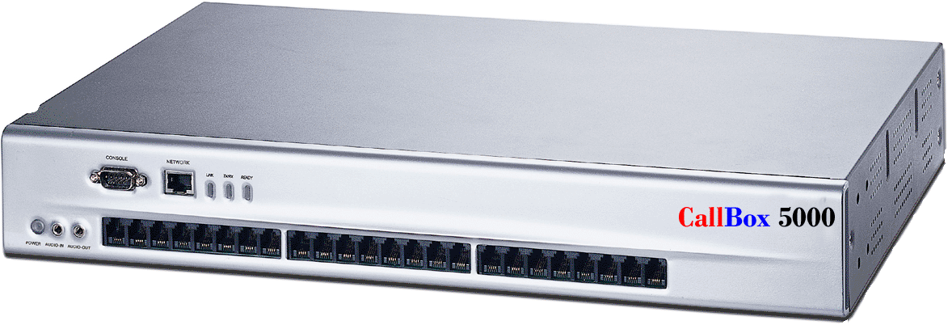
CUSTODY® affordable - expandable - dependable
Next Generation Call / Voice Logging Technology

Slide 3


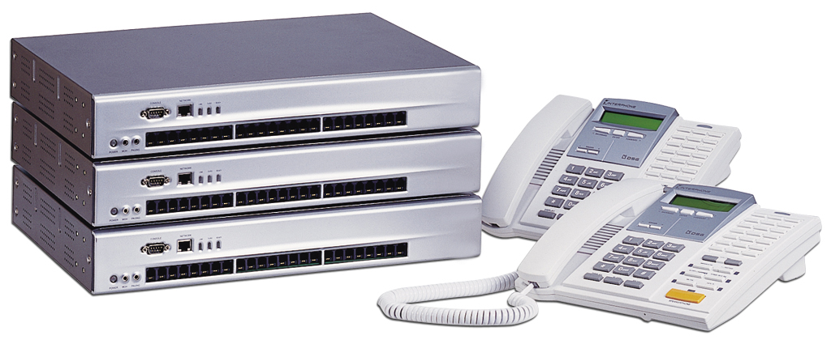
CUSTODY® CallBox 5000
Digital Call Logger ™
Affordable, Scalable, Dependable
IP Based Voice / Call logging
Technology
.
Next Generation Call / Voice Logging Technology

Slide 4

CUSTODY® CallBox 5000
IP Based Digital Voice / Call Logger Recorder
Capture
Analyze
Report
Recall

Slide 5
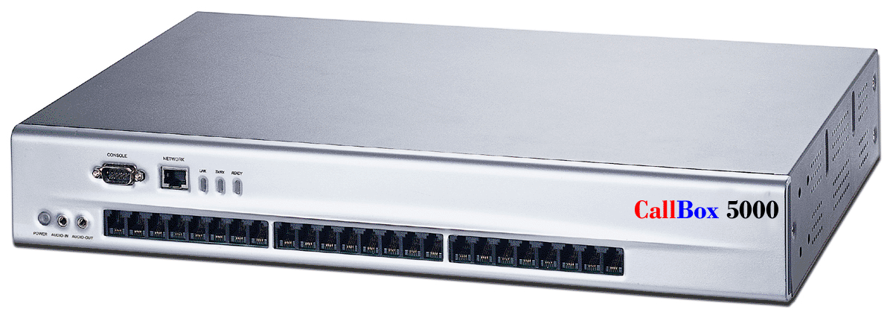
CUSTODY® CallBox 5000 Affordable, IP Based Digital
CallBox 5000
breaks the
boundary of traditional
PC-based loggers
by connecting
the administrator with multiple recording sites,
taking
call logging to a whole new level
New York
Denver
Atlanta
Denver
Los Angeles
Washington
Next Generation Call / Voice Logging Technology

Slide 6
CUSTODY® CallBox 5000 Affordable, IP Based Digital
CallBox 5000 is engineered to operate over a
Non-PC dedicated hardware platform, eliminating the vulnerability of personal computers.
CallBox 5000 is also based on a secure / dedicated operating
system, dramatically raising the level of stability and security.
CallBox 5000 utilizes the 4 channel dedicated modular upgrade capability, tailors to your agency’s size and budget.
LINUX OS

Slide 7
CUSTODY® CallBox 5000 Affordable, IP Based Digital
CallBox 5000 is equipped with a high performance HD capable
of storing up to 40,000 hour/channel handling up to up to 24 lines per unit. Backup can also be done real-time or by user defined schedule to any available network device including HD, DVD RAM, and MO.

Slide 8
CUSTODY® CallBox 5000 Affordable, IP Based Digital
CallBox 5000 System Functions
Single logger supports from 4 up to 24 recording channels.
Stackable up to 1000 recording channels.
Supports Windows 98, NT, 2000 and XP
Software Upgrade via Internet

Slide 9
CUSTODY® CallBox 5000 Affordable, IP Based Digital
Search and Play
CallBox allows multiple users to Search & Play simultaneously
via TCP/IP protocol
Powerful Search by:
Last 10, Last 50, Logger ID, Date, Time, Extension Number,
Recording Channel, Caller ID, Trunk Line, Dialed Number,
and many more call attributes.
Small Footprint:
2.5”H x 10 ¾” D x 17 ½”W
Only 7.75 lbs!

Slide 10
CUSTODY® CallBox 5000 Affordable, IP based Digital
Playback can be done by logger (Speaker needed),
Remotely by PC.
Skip Forward/Backward,
Continues Play, Selective Play and Volume Control
during record playback.
Files can be converted to WAVE format.

Slide 11
CUSTODY® CallBox 5000 Affordable, IP Based Digital
CallBox 5000 Multiple Levels of Administration
Up to 10 sets of different CallBox administrators-Functions
can be independently assigned to administrators, providing
flexible COS.

Slide 12
CUSTODY® CallBox 5000 Affordable, IP Based Digital
CallBox
CD/RW-Support Redundancy to HD, DAT, MO, DVD RAM,
RAID1, RAID5
Support FAT, FAT32, NTFS Format

Slide 13
CUSTODY® CallBox 5000 Affordable, IP Based Digital
CallBox 5000 System Functions
Recording Ring Beep
System Self-Diagnose, send E-mail and
system error beep.
Front Panel LED indicating the status of each recording
channel, power, and RX/TX standing.

Slide 14
CUSTODY® CallBox 5000 Affordable, IP Based Digital
CallBox Recording Parameters
Recording Schedule and Recording channels independently
define recording parameters with VOX (Hi/Mid/Low),
voltage and Max/Min recording time
Silence Detection, and CODEC.-Flexible Schedule and
Record-on-Demand.
Recording Status Check by recording
channel

Slide 15
CUSTODY® CallBox 5000 Affordable, IP Based Digital
Playback can be done by logger (speaker needed),
remotely by PC.
Skip Forward/Backward,
Continues Play, Selective Play and Volume Control
during record playback.
Files can be converted to WAVE format.

Slide 16
CUSTODY® CallBox 5000 Affordable, IP Based Digital
CallBox Recording Parameters
Recording Schedule and Recording channels independently
define recording parameters with VOX (Hi/Mid/Low),
voltage and Max/Min recording time
Silence Detection, and CODEC.-Flexible Schedule and
Record-on-Demand.
Recording Status Check by recording
channel

Slide 17
CUSTODY® CallBox 5000 Affordable, IP Based Digital
CallBox Logger Data Storage up to 40,000 hour/channel.
(variable with selected Hard Disk)
Selectable Manual Backup, Real-Time Backup,
Scheduled Backup
Backup Storage Device includes: DAT(DD3, DD4), DVD,

Slide 18
CUSTODY® CallBox 5000 Affordable, IP Based Digital
States Requiring One Party Notification
Alabama Alaska Arizona Arkansas Colorado District Of Columbia Georgia Hawaii Idaho Indiana | Iowa Kansas Kentucky Louisiana Maine Minnesota Mississippi Missouri Nebraska Nevada | New Jersey New Mexico New York North Carolina North Dakota Oklahoma Oregon Ohio Rhode Island South Carolina | South Dakota Tennessee Texas Utah Vermont Virginia West Virginia Wisconsin Wyoming

Slide 19
CUSTODY® CallBox 5000 Affordable, IP Based Digital
States Requiring Two Party Notification
California Connecticut Delaware | Florida Illinois Massachusetts | Maryland Michigan Montana | New Hampshire Pennsylvania Washington

Slide 20
CUSTODY® CallBox 5000 Affordable, IP Based Digital
Model Numbers | Factory Direct Agency Price
CV-CB 4P | includes 1 year parts and labor plan
CV-CB 8P | includes 1 year parts and labor plan
CV-CB 12P | includes 1 year parts and labor plan
CV-CB-16P | includes 1 year parts and labor plan
CV-CB 20P | includes 1 year parts and labor plan
CV-CB 24P | includes 1 year parts and labor plan
Expansion Card | includes 1 year parts and labor plan

Slide 21
CUSTODY® CallBox 5000 Affordable, IP Based Digital
Model Number | Description
CV-AR- 1 | Advance replacement of any CV-CB
CV-SP-3 | Full 3 year Warranty Service Plan

Slide 22
CUSTODY® CallBox 5000 Affordable, IP Based Digital
Available with non-appropriation fund leasing. If your agency can’t get funding after the first year, just return the device. No problem
Lease rates starting at only $104 per month!!!

Slide 23
CUSTODY® CallBox 5000 Affordable, IP Based Digital
Available with non-appropriation fund leasing. If your agency can’t get funding after the first year, just return the device. No problem
Lease rates starting at only $104 per month!!!

Slide 24
CUSTODY® CallBox 5000 Affordable, IP Based Digital
For additional information and the name of your local CallBox 5000 Rep
Call 1-866-277-5098

